Slide 1

FermaLogis
Employee Turnover Analysis
By: Chandrashila Chattopadhyay
Vinny Franchin
Ashwini Nadupuri
Haley Reierson
Stephanie Wallace
July 6, 2020

Slide 2
Agenda
Project Scope
External Research
Data Description
Data Processing
Data Exploration
Data Modeling
Model Comparison
Findings & Results
Recommendations

Slide 3

Business Problem
FermaLogis, a successful pharmaceutical company, is experiencing a rise in employee turnover. Despite significant investments in training programs for both new and experienced personnel, the company continuously experiences vacancies and unrealized returns on investment. Larry Hansen, COO, is seeking analytical assistance to uncover the drivers of the company’s turnover so they can adopt the needed changes and techniques to minimize future employee turnover.

Slide 4
Quote Inspiration
“Employees who are engaged are more likely to stay with their organization, reducing overall turnover and the costs associated with it. They feel a stronger bond to their organization’s mission and purpose, making them more effective brand ambassadors. They build stronger relationships with customers, helping their company increase sales and profitability.”
Source: https://www.engagementmultiplier.com/blog/15-best-quotes-employee-engagement-gallups-2017-report/

Slide 5
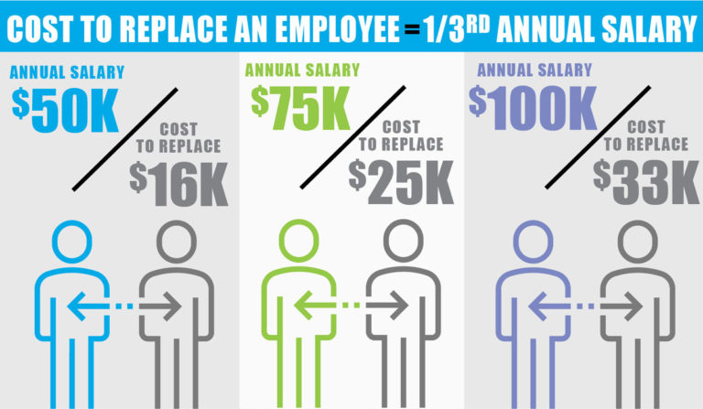
External Research
Source: https://www.madisonapproach.com/retaining-top-employees-reduces-cost-of-employee-turnover/

Slide 6

General Drivers Of Employee Turnover
Career Training
Workplace
Manager Behavior
Job Features
Pay & Benefits
Work Life Balance

Slide 7

Turnover Statistics
80% of all employee turnover is the result of poor hiring decisions.
Average annual turnover rate is 19%.
On average it takes 1-2 years for a new employee to be fully productive in their role.
A highly engaged workforce can reduce a company’s turnover rate by 25-59%.
92% of workers believe that having strong empathetic leaders is critical to strong retention.
48% of employees say that if leadership asked for their feedback and acted on it, it would help to reduce voluntary turnover.
Source: https://builtin.com/employee-turnover-statistics

Slide 8
Data Description
For this project initiative, FermaLogis has provided details of its employee workforce in a CSV file. Each row of information is at an individual employee level and contains demographic information surrounding age, gender, marital status, and education, as well as job, tenure, performance, and compensation information.
Demographic
Job
Tenure
Performance & Compensation
Age
Gender
Marital Status
Education
Current Role
Operational Involvement Level
Hours Worked
Job Satisfaction
Company Tenure
Current Role Tenure
Current Manager Tenure
Manager Evaluation
Salary
Bonus History
Trainings Attended

Slide 9
Data Processing
Original dataset provided by FermaLogis contained 1,470 records and 79 columns of variables.
Data Simplification
Remove unwanted columns
Remove columns where information was consistent across all records
Handling Missing Values
Recode NA’s from “Bonus” columns 1-40 to 0
Transition “Bonus” columns from text to numeric variables
Variable Creation
Develop variable “Turnover Type” a numeric mapping of variable “Type”
New variable allows comparison of existing vs. turned employees

Slide 10
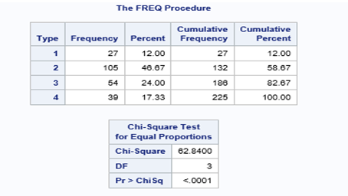
Data Exploration
“Turnover Type” = 2 (Voluntary Resignation) accounts for almost half of the observations at 46.67% (105 out of 225 sample records).
“Turnover Type” = 1 (Retirement) accounts for the smallest percentage of turnover, at 12% (27 out of 225 sample records).
80% of employees that voluntarily resigned were not satisfied with the company’s facilities
70% of employees that voluntarily resigned either received or was intending on pursuing a higher education
60% of employees who voluntarily left FermaLogis were working more than 10 hours of overtime a week.
We developed a sample dataset for exploration that contained a total of 225 records.

Slide 11
Data Modeling – Part 1
We created a series of Cox Proportional Hazards (PH) models. This model type focuses less on when a particular event occurred, rather, the order particular events occurred.
Schoenfeld Residual Analysis - used to check proportionality around the hazard assumption, including time dependent covariates.
Martingale Residuals - used to assess any potential nonlinearity.

Slide 12
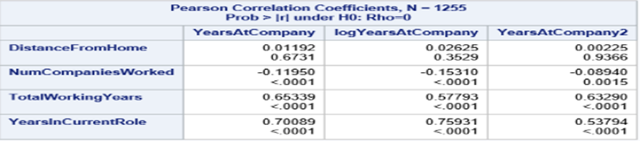
Data Modeling – Part 2
Correlation Matrix shows the following:
“Distance from Home” is not correlated with any time dependent interactions of “Years At Company”.
“Number of Companies Worked”, “Total Working Years’, and “Years In Current Role” have significant time dependent interactions with “Years At Company”.
“Total Working Years” and “Years In Current Role” have a positive correlation with “Years At Company”.
“Number of Companies Worked” has a negative correlation with the variable “Years At Company”.

Slide 13
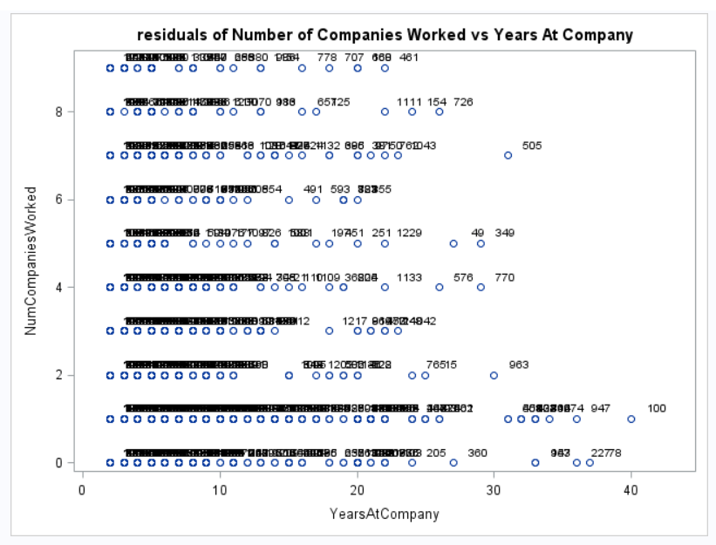
Data Modeling – Part 3
Residual Plot – “Number of Companies Worked” vs. “Years At Company”:
A higher “Number of Companies Worked” corresponds more often to “Years At Company” of 5 years or less.
“Number of Companies Worked” is a time dependency with this variable.

Slide 14
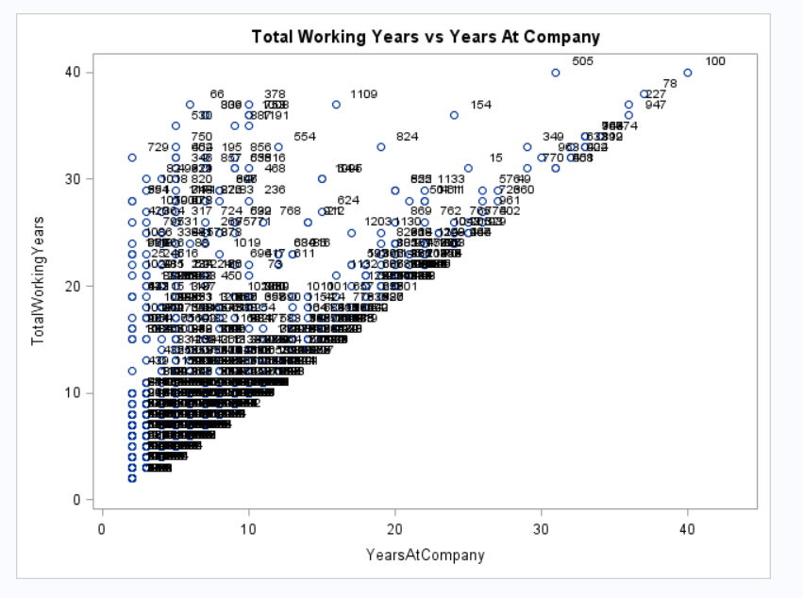
Data Modeling – Part 4
Residual Plot – “Total Working Years” vs. “Years At Company”:
As the “Total Working Years” for an employee increases, “Years At Company” also increases showing a direct correlation; making “Total Working Years” a time dependent variable.

Slide 15
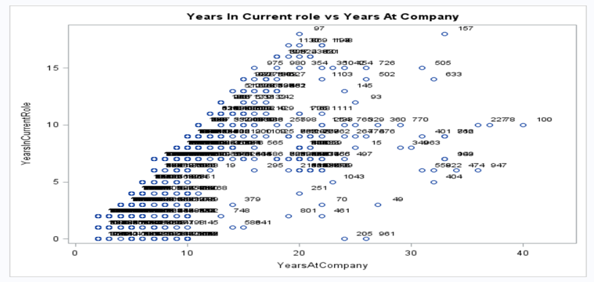
Data Modeling – Part 5
Residual Plot – “Years In Current Role” vs. “Years At Company”:
As an employee’s years or service at the company are increasing, the “Years In Current Role” are also increasing; showing a positive correlation.
“Years In Current Role” is a time dependent variable.

Slide 16
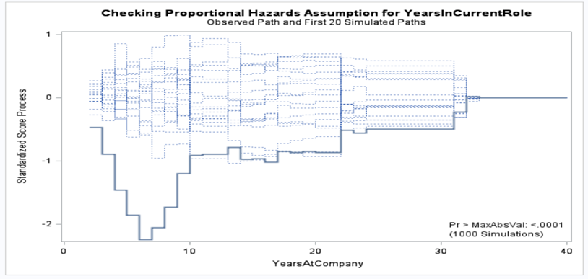
Data Modeling – Part 6
Martingale Residual Plot – “Years In Current Role”:
“Years In Current Role” is a non-proportional variable in the Martingale residual plot of the Standardized Score Process against “Years At Company”.
Deviations of actual vs. observed can be observed in the Martingale residual plot, with the largest deviation occurring around year 7.

Slide 17
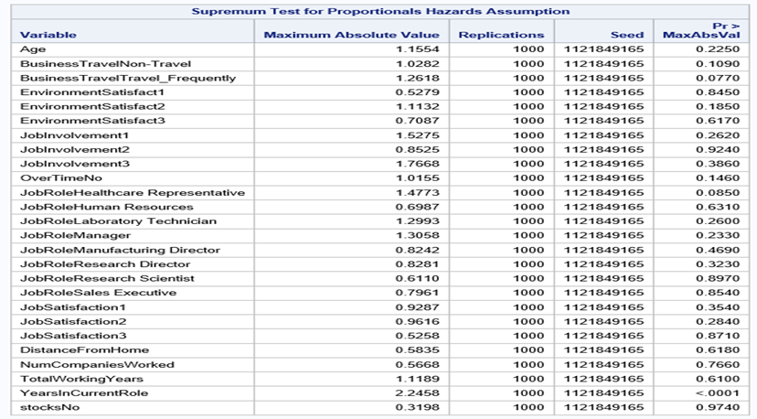
Data Modeling – Part 7
Supremum Test for Proportional Hazards Assumption:
Above exhibit shows the maximum absolute value of covariates across the analyzed variables.
This test yielded non-significant P-values for all covariates with the exception of “Years In Current Role”.
The significance of one covariate with this test, tells us that the proportional hazards assumption holds for most of the covariates.
We have evidence to conclude that “Years In Current Role” has a significant time interaction with the target variable.

Slide 18
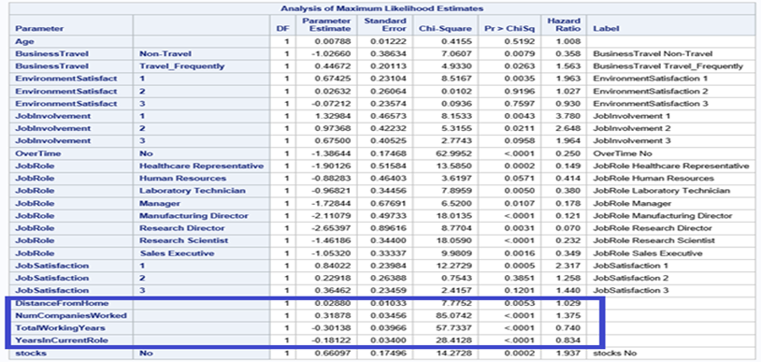
Data Modeling – Part 8
Schoenfeld Statistics Exhibit:
Parameter estimates for “Distance From Home”, “Number of Companies Worked”, Total Working Years”, and “Years In Current Role” are all significant, which means that their hazard function changes over time.
All of the previously mentioned variables are not proportional.
It is important to note that from our correlation matrix, we saw that “Distance From Home” had no significant time interaction with the variable “Years At Company”.

Slide 19
Data Modeling – Part 9
Three types of models were developed to analyze the response variable with respect to each turnover type; retirement, voluntary resignation, involuntary resignation, and termination. The three models we developed are:
Combined Model
Nested Model
Individual Models
Performed the best!
All four turnover types are studied together in one model.
Similar turnover types were analyzed together; involuntary resignation and termination
One model developed for each of the four turnover types to analyze separately.

Slide 20
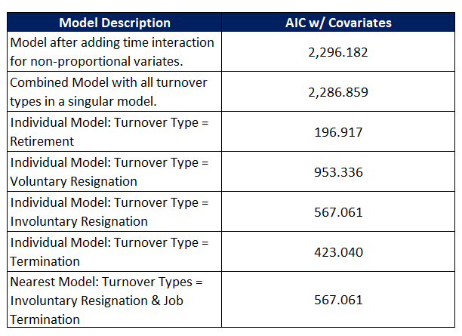
Model Comparison
When comparing the developed models, AIC was used as a comparative statistic. AIC estimates the likelihood of a model’s ability to predict/estimate values in the future. The smaller the AIC, the better the models comparative ability to predict future results.
Best Model!!!

Slide 21
Findings & Results By Turnover Type
Retirement
Voluntary Termination
Age was the most significant factor.
For every 1 year increase in age, there is a 51% risk in the employee leaving.
Employees who travel frequently for work are 830 times more likely to leave than those who do not travel for work.
Employees who do not work overtime are 11.5% less likely to leave than those who do work overtime.
Many factors influenced turnover in this group:
Business Travel
Overtime
Job Satisfaction
Stocks
Years in Current Role
Low job satisfaction has the highest hazard ratio.
Employees with low job satisfaction are 585 times more likely to leave the company than those with medium or high satisfaction.
Involuntary Termination
Termination
Many factors influenced turnover in this group:
Overtime
Years Worked
Current Role
Number of Companies Worked
Overtime was the most significant factor.
Employees working overtime are 75% more likely to involuntarily resign than those employees who do not work overtime.
Significant job roles include; Lab Tech, Manufacturing Director, and Research Scientist.
Years in Current Role & Age were the most significant factors.
For every additional year in Current Role, the risk of leaving is 7.2%
For every 1 year increase in age, there is an 87.8% chance of getting terminated.

Slide 22

Who is leaving the company?
By and large, the employees who are leaving the company are voluntarily resigning within the first few years of being hired.
Majority of those employees voluntarily leaving the company are receiving a higher education.
More men than women make up the voluntary turnover population.
More often than not, the jobs most associated with this voluntary turnover population have a background in either Medicine or Life Sciences.

Slide 23

Why are they leaving the company?
A poor environment has a huge impact on employee engagement and moral. When the working environment suffers, employees become less productive and begin to feel disconnected from their work, all of which lead to low job satisfaction.
Working too much also has a significant impact on turnover from both a voluntary and involuntary perspective. There is a fine line between feeling valued and feeling overworked. When employees feel overworked and underappreciated, the only natural next step is to find a job that will pay for their performance and give them the work-life balance they desire.

Slide 24

Recommendations
Hire: Take special care when hiring. Make sure the expectations of the position align with the expectations of the individual being hired. Validate that the prospect will be a good culture fit. Understand their near-future plan.
Train: Take the time to onboard new employees of the company and those new to their current role. Give the employee the tools to succeed. Set them up with a mentor and make sure they feel empowered to ask questions and think outside of the box.
Motivate: Foster an environment that promotes collaboration and creativity. Give employees the ability to have a voice and feel heard. Simply asking “How are you doing?” can give you, the manager, a clear pulse on things.
Retain: Make employees feel valued. Not only show their value through compensation efforts, but give them insight into the potential growth opportunities that exist, and walk them through what you need to see to take them to the next level.

Slide 25
References

